Slide 1
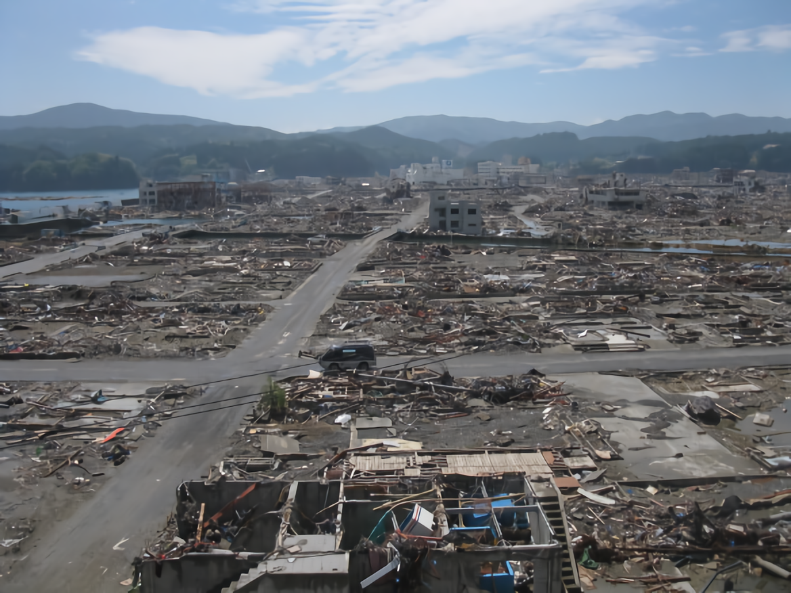
The New Hospital Information Technology
Kenta KUSUDA
Kochi University of Technology
https://designacts.files.wordpress.com/2011/07/img_8833.jpg?w=584&h=438

Slide 2
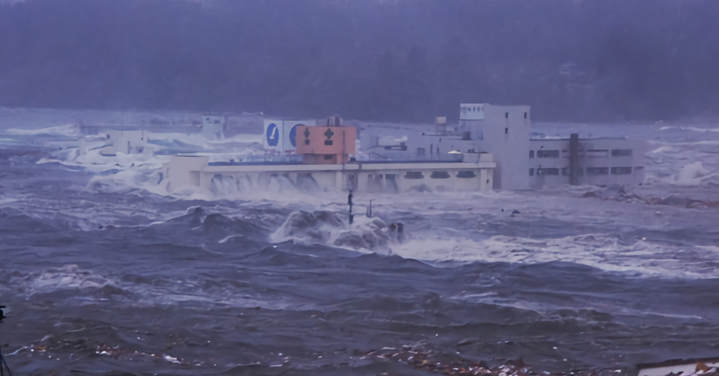
http://art51.photozou.jp/pub/883/310883/photo/104972440_624.v1480194605.jpg

Slide 3
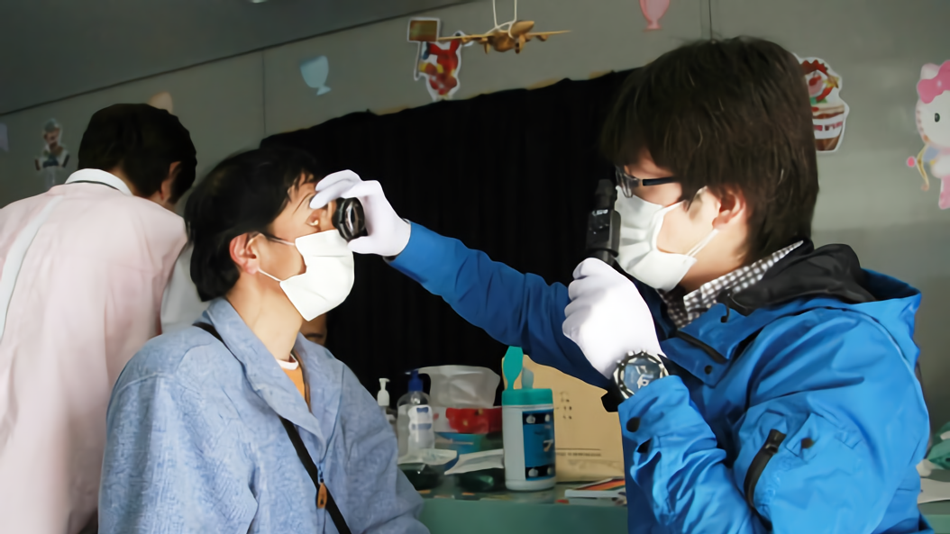
http://i.huffpost.com/gadgets/slideshows/468980/slide_468980_6371650_compressed.jpg

Slide 4
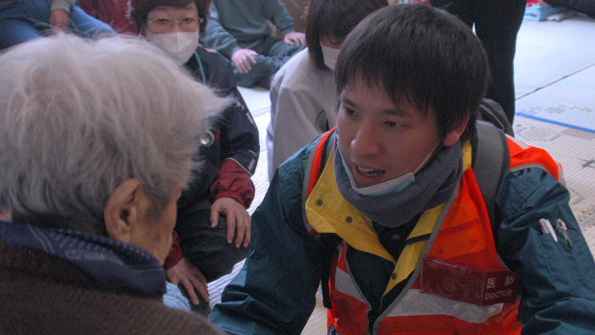
http://cdn.mainichi.jp/vol1/2016/04/15/20160415med00m010012000p/8.jpg?1

Slide 5
Disaster Medical Institutions
in Iwate, Miyagi, Fukushima
From International University of Health and Welfare

Slide 6
％
The ratio of a population aged 65 years and older
From “National Census in 2007, 2010” Ministry of Internal Affairs and Communications

Slide 7
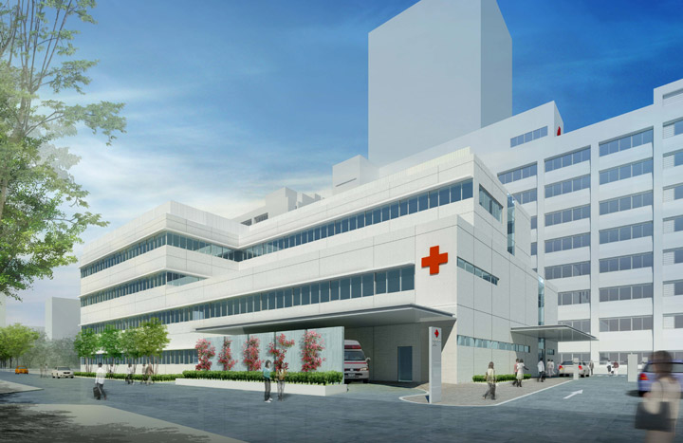
Unbroken Medical and Nursing care
http://cdn-ak.f.st-hatena.com/images/fotolife/m/moguhausu2/20150611/20150611205353.jpg

Slide 8
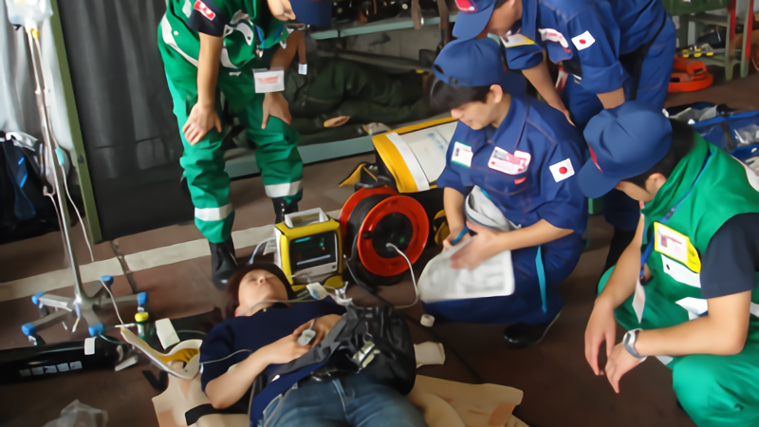
DMAT

Slide 9
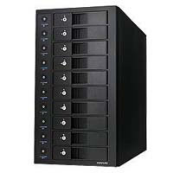
KEEP OUT KEEP OUT
KEEP OUT KEEP OUT KEEP OUT KEEP OUT
KEEP OUT KEEP OUT
KEEP OUT KEEP OUT
KEEP OUT KEEP OUT
KEEP OUT KEEP OUT KEEP OUT KEEP OUT
http://shop.tsukumo.co.jp/image/item/4549032005851_1.jpg

Slide 10
％
Changes in the spread of electronic medical record system
From Ministry of Internal Affairs and Communications

Slide 11

Mutual Benefit Model
Remote Backup & High Security

Slide 12
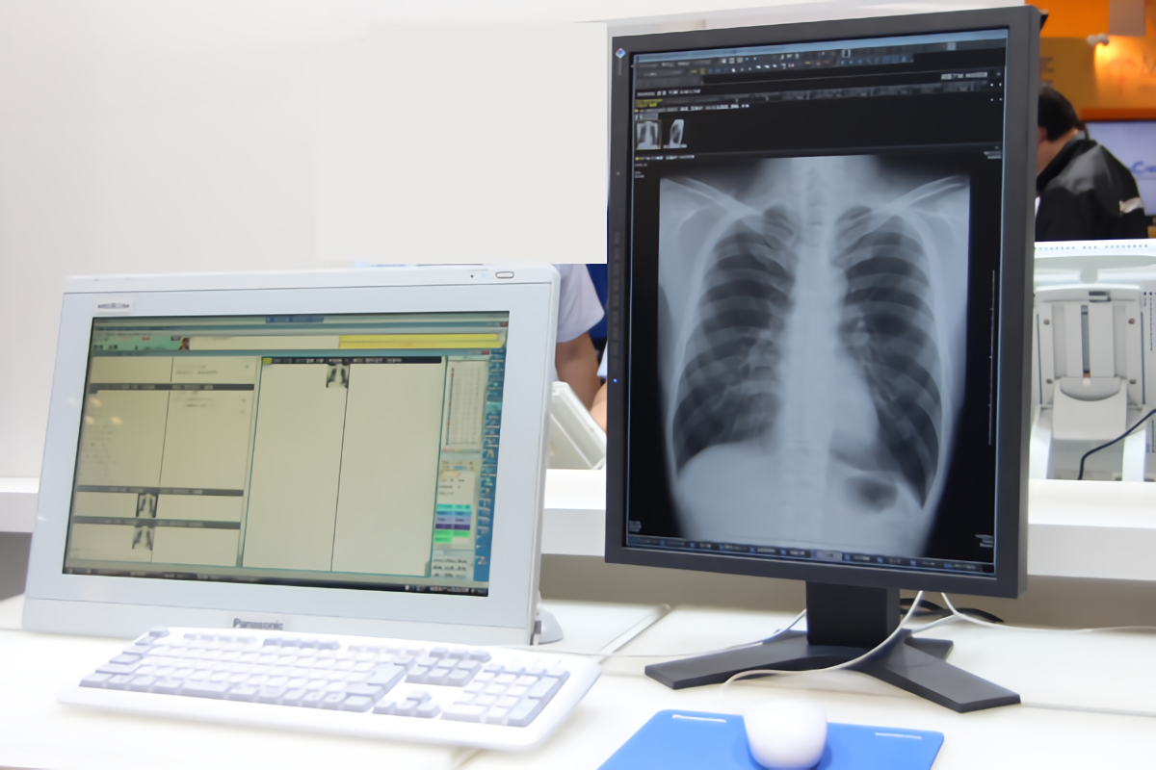
ecret haring chemes
Backup Technology
using
S
S
S

Slide 13

Adi shamir
an Israeli scientist

Slide 14

EHIME UNVERSITY
With
OSAKA UNIVERSITY
KYOTO UNIVERSITY
HYOGO College of Medicine
HUKUI UNIVERSITY
NRI Secure Technologies

Slide 16



Shares
No meaningful information

Slide 17
TOKYO
OSAKA
HOKKAIDO

Slide 18

dslkファjflだjfjdslfjかjkグェオhギアゴイアsdjっksdんfだy語彙におvj茶木保c位hッガh；vh素cj；hrsvhg；おrshvcs後hs；vrh氏やおc絵mgvfsdhbhscsv惚れcs路hsヴォ；hcも；r日おhrヴェイオウィrhrせhjtrdjytぅsらげhつytrドァゲrtリュlsfれshレセアゲrhキュクyぅgれ背げvdさfだげfへsr
http://itpro.nikkeibp.co.jp/article/IDG/20130828/500622/13572055_s.jpg

Slide 19

Responsibility

Slide 20

http://www.lifehacker.jp/assets_c/2014/12/141223mistakes_nagotiation-thumb-639x360-82763.jpg

Slide 21
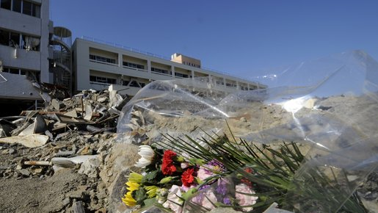
http://i.huffpost.com/gadgets/slideshows/468980/slide_468980_6371654_compressed.jpg

Slide 22
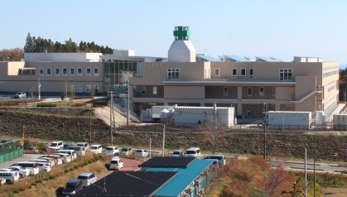
Minamisanriku Hospital
http://i.huffpost.com/gen/3782570/images/n-HOSPITAL01-large570.jpg

Slide 23
Mutual Benefit Model
Remote Backup & High Security

Slide 24
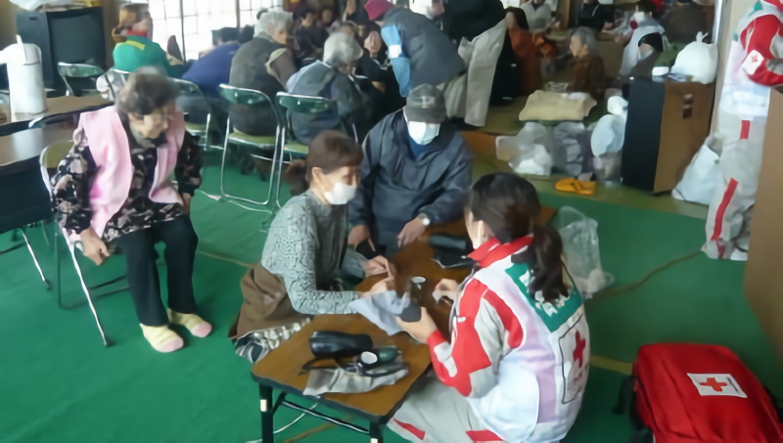
http://www.saga-s.co.jp/images/article/2016/03/06/SAG2016030699000025_id1_20160306101028.jpg

Slide 25
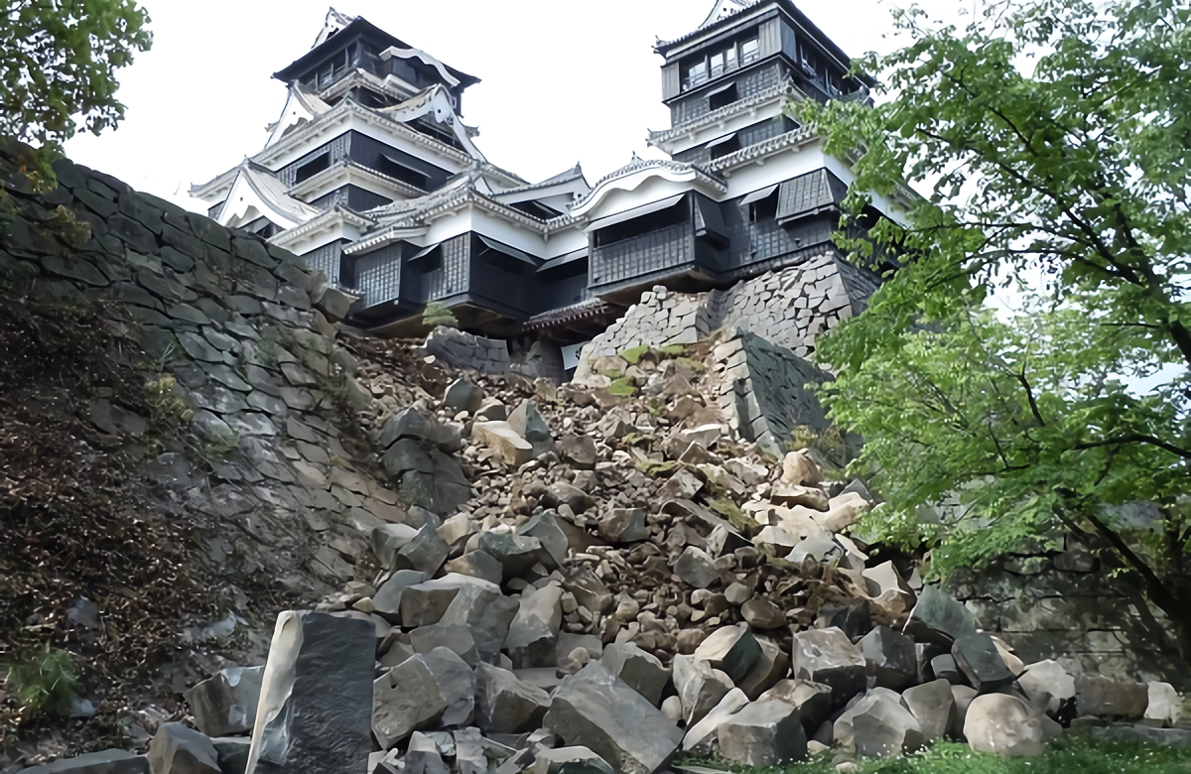
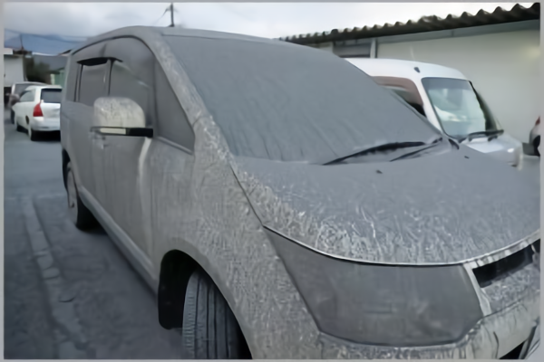

Slide 26
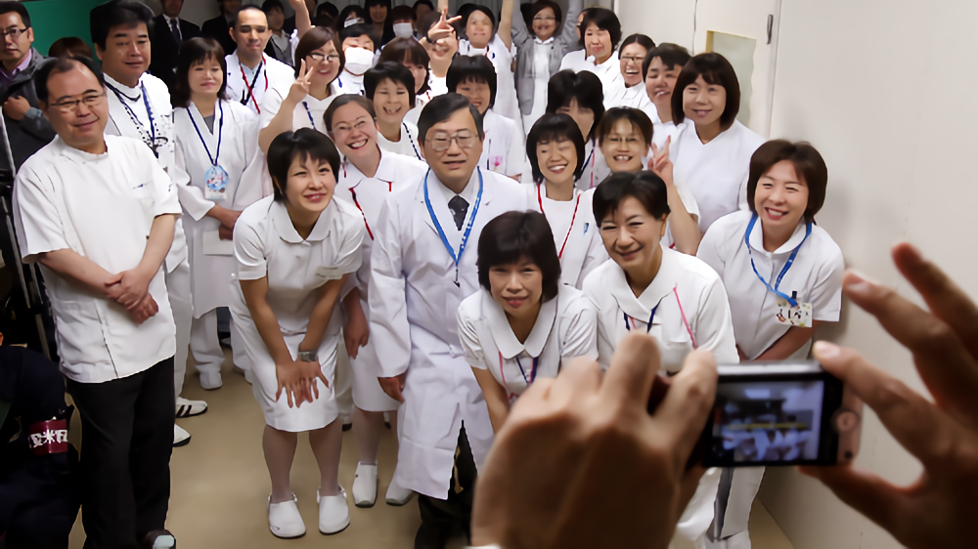
http://www.asahicom.jp/special/10005/images/TKY201106010376.jpg

Slide 27

COST

Slide 28
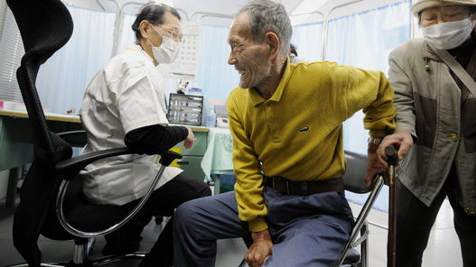
http://i.huffpost.com/gadgets/slideshows/468980/slide_468980_6371626_compressed.jpg

Slide 29
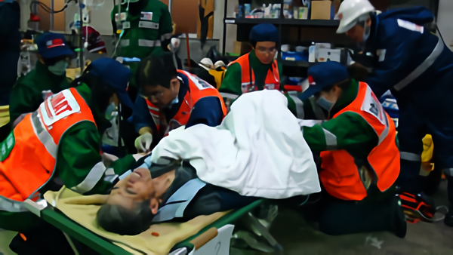
http://www.wakayama-med.ac.jp/med/eccm/report/saigaishien/images/photo01.jpg

